Slide 1
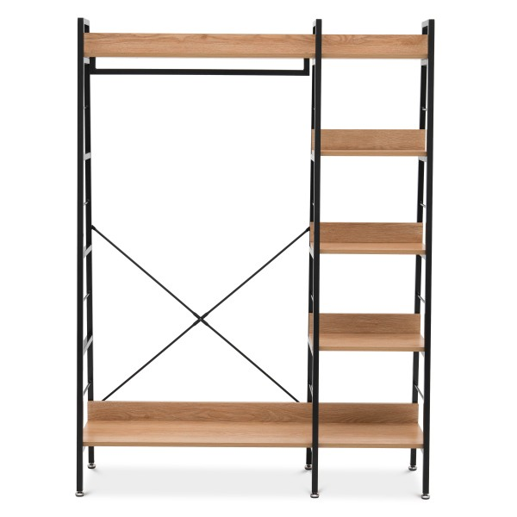
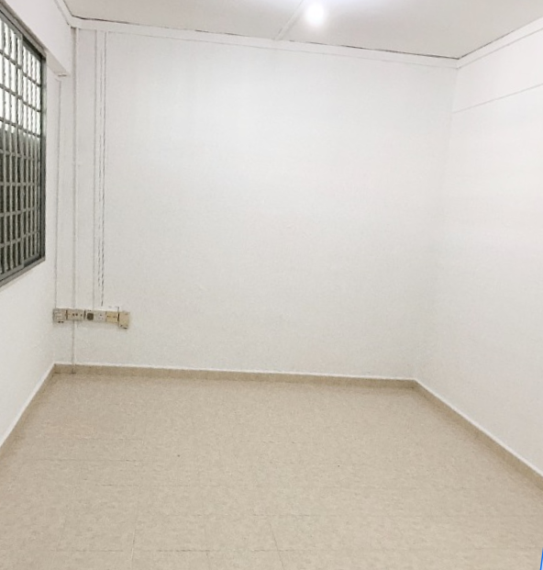
ultrasonic
ultrasonic
weight
weight
weight
weight
weight
weight
Shelves/ Closets/ Storage
Room / Floor

Slide 2


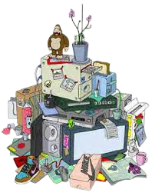
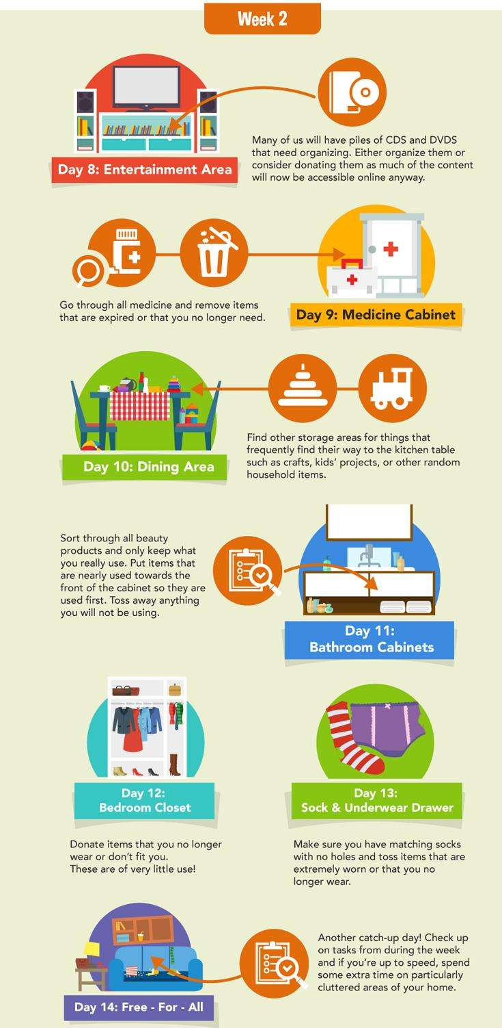
Ultrasonic sensor
Panel
Infographic
Hoarding pile
LED light
weight sensor

Slide 3


Ultrasonic sensor
Panel
Infographic
LED light
weight sensor

Slide 4
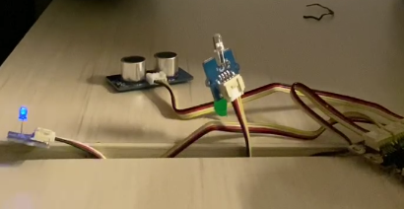
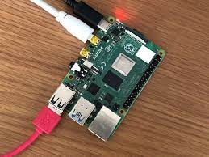
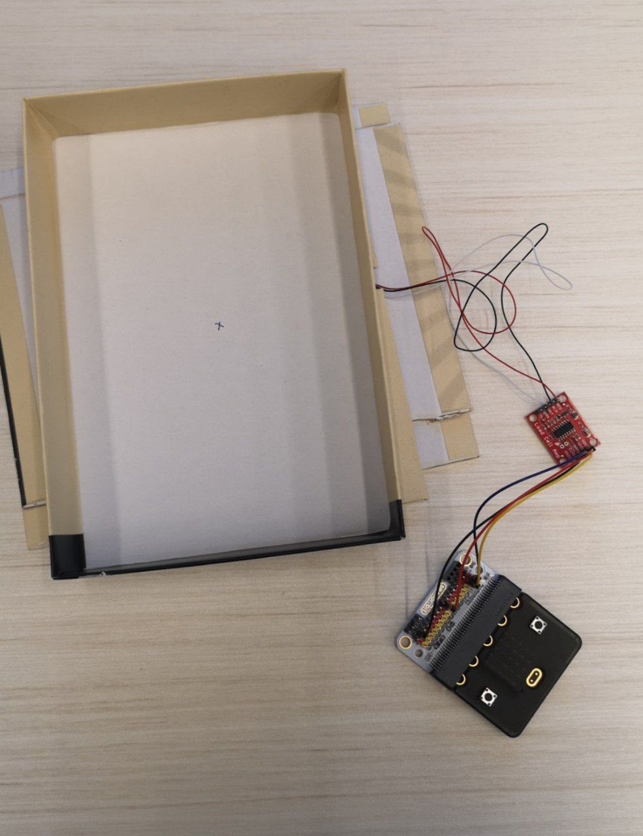
Ultrasonic Sensor
SMS Alert
BlueTooth
Raspberry Pi
Cloud Database
Weight Sensor
BlueTooth
Tableau Data Viz

Slide 5
Ultrasonic Sensor
Telegram
BlueTooth
Raspberry Pi
Cloud Database
Weight Sensor
BlueTooth
Tableau Data Viz

